Slide 1
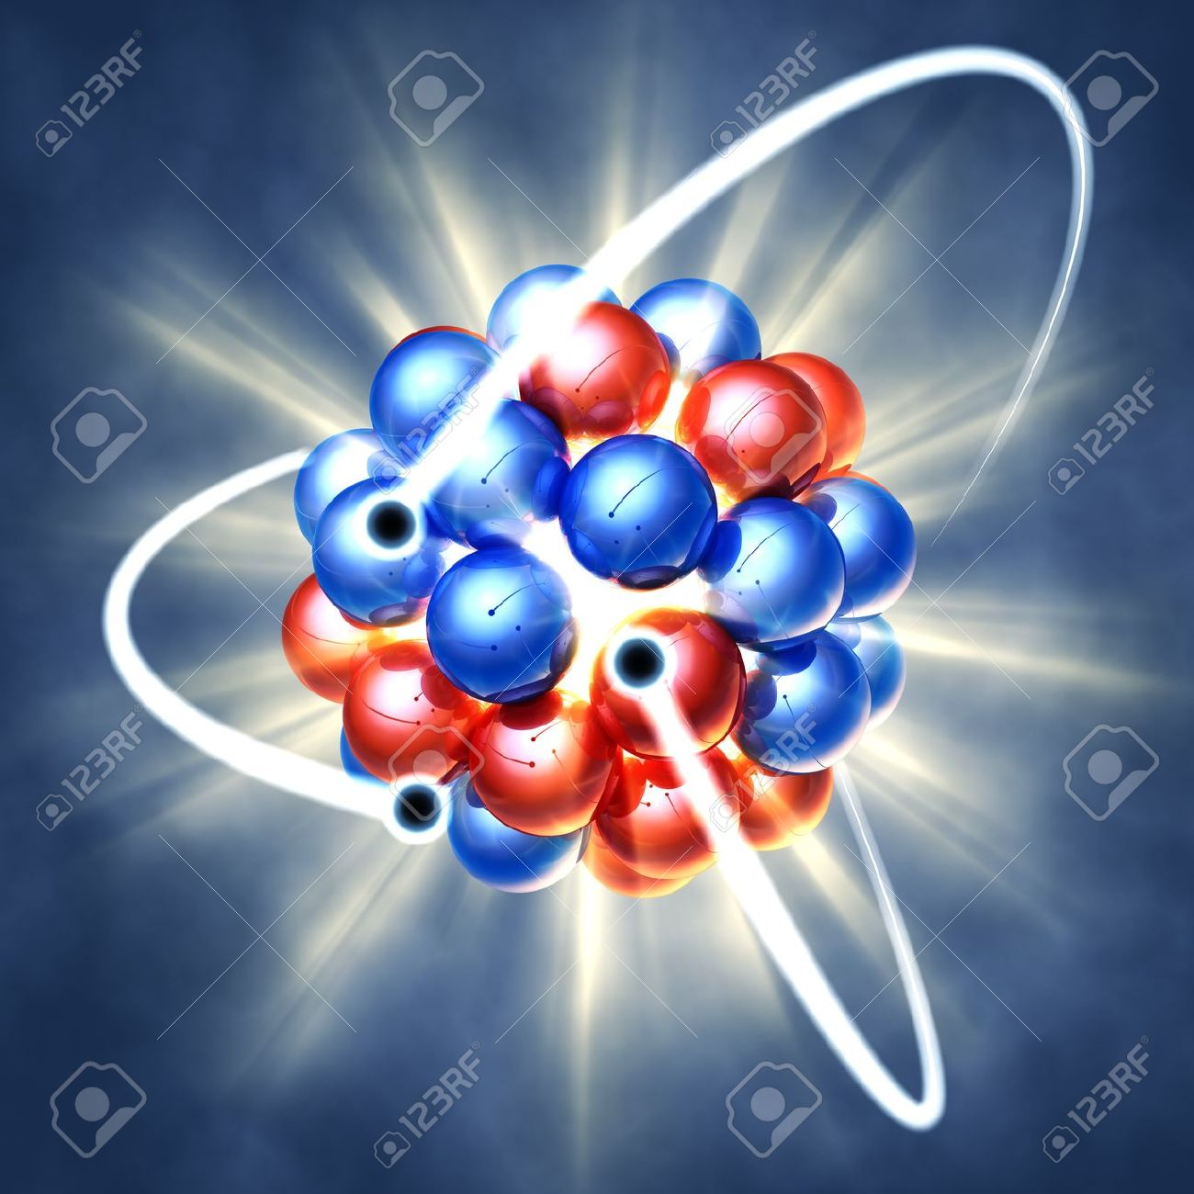
Atoms and their Parts
Yayyyyyyyy Atoms!

Slide 2
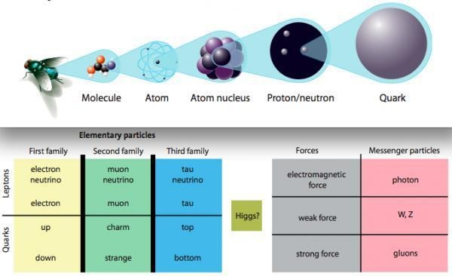
Refresher…
Everything is made up of matter, which is something that has mass and takes up space
Atoms- the smallest piece of matter, the building blocks of everything

Slide 3
Atoms are made of two distinct parts
1. The Nucleus
2. The electron cloud

Slide 4
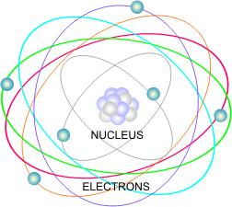
1. The Nucleus
Nucleus- the center of the atom that contains all its MASS
Contains protons and neutrons

Slide 5
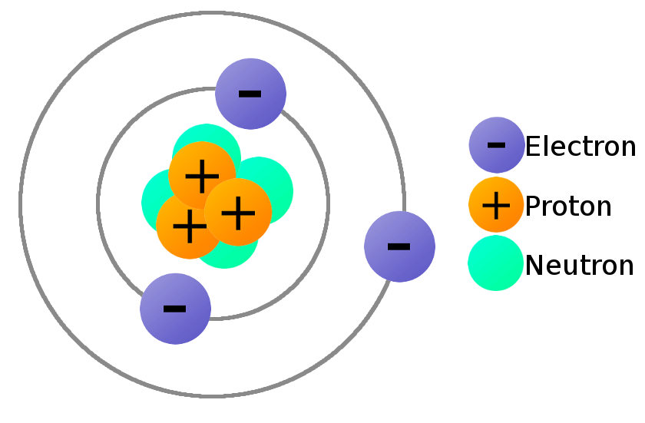
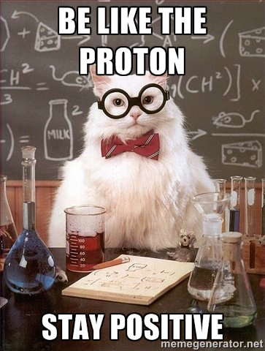
Protons
Protons (p⁺)- positively charged particles, has a charge of +1, has a mass of one, found in nucleus
1 proton = +1 charge
5 protons = +5 charge
1,000,000,000 protons = +1,000,000,000 charge

Slide 6
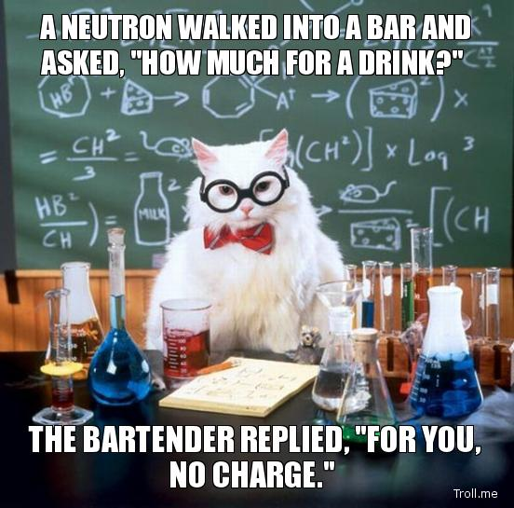
Neutrons
Neutrons (n⁰)- NEUTRALLY charged particles, has a charge of 0, has a MASS of one, found in nucleus
1 neutron = 0 charge
5 neutrons = 0 charge
1,000,000,000 neutrons = 0 charge

Slide 7
Questions…
A nucleus contains 4 protons and 3 neutrons. What is its overall charge?
So… no matter what, the nucleus has a ___________________ charge. (Hint, hint)

Slide 8
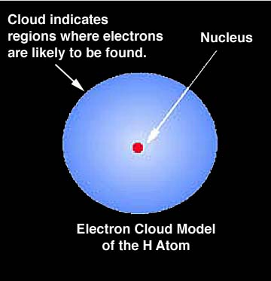
2. The Electron Cloud
Electron cloud- Region around the nucleus where you find the electrons
Contains electrons
Takes up almost all the SPACE

Slide 9
Electrons
Electrons (e⁻)- negatively charged particle, has a charge of -1, that HAS NO MASS, found in the electron cloud

Slide 10
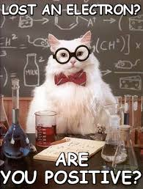
Questions
1. An atom has 4 protons and 4 electrons. What is its charge?
2. An atom lost an electron. It now has 4 protons and 3 electrons. What is its charge?

Slide 11
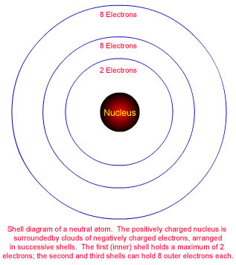
Electron Orbitals
Different electrons orbit the nucleus in different places
They can be found in different orbitals

Slide 12
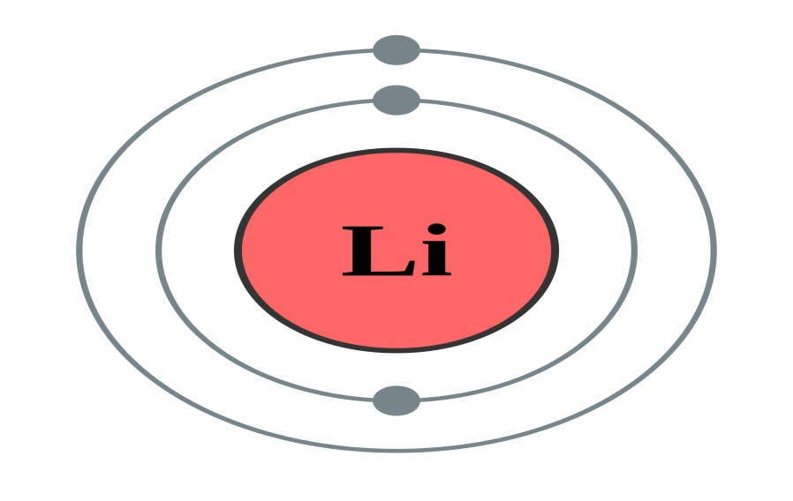
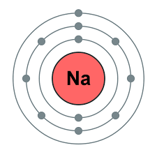
The ‘Orbital Rule’
1st Shell- can only hold up to TWO electrons
2nd Shell- Can hold up to EIGHT electrons
3rd Shell- Can hold up to EIGHT electrons (really 18, but for our class it will be 8)
Lithium- 3 electrons
2 in first shell
1 in second shell
Sodium- 11 electrons
2 in first shell
8 in 2nd shell
1 in 3rd shell

Slide 13
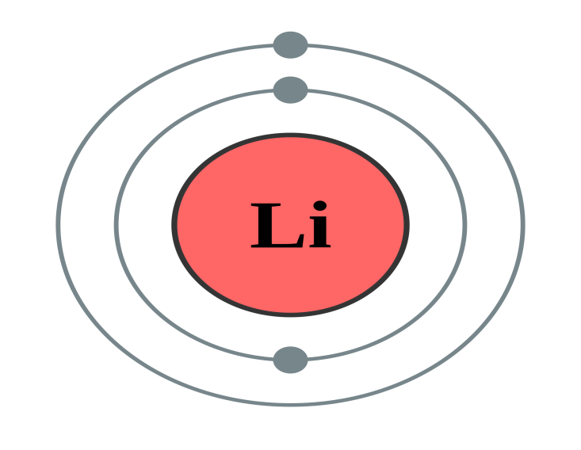
Valence Electrons
Valence Electrons- the electrons found in the OUTER orbital of an atom
These are the electrons that allow an element to bond
Both of these atoms have ONE valence electron… so they can bond with ONE other thing

Slide 14
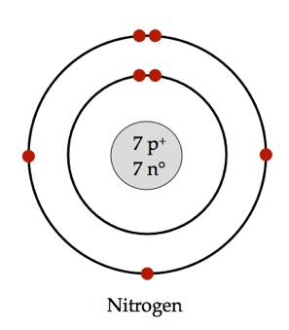
Question:
1. How many valence electrons does Nitrogen have?

Slide 15
Periodic Table
Atomic Number:
Number of protons and it is also the number of electrons in an atom of an element.
8
Element’s Symbol: An abbreviation for the element.
O
Elements Name
Oxygen
Mass #:
Number of protons + neutrons.
16

Slide 16
Some other important notes
In elements: the number of protons ALWAYS,ALWAYS, ALWAYS equals the number of electrons
So all atoms are NEUTRAL (zero charge)
Protons (+) equals electrons (-)
6 protons + 6 electrons = 0
(+6) + (-6) 0

Slide 17
To find the mass number of elements: add the protons and neutrons
Electrons DON’T have mass, so you do not include them in the mass number

Slide 18
Conceptual Pictures of elements…

Slide 19
The Atom Fluorine
Protons
Electrons
Neutrons
Fluorine has nine electrons, nine protons and ten neutrons.

Slide 20
The Atom Boron
Protons
Electrons
Neutrons
Boron has five electrons, five protons and six neutrons.

Slide 21
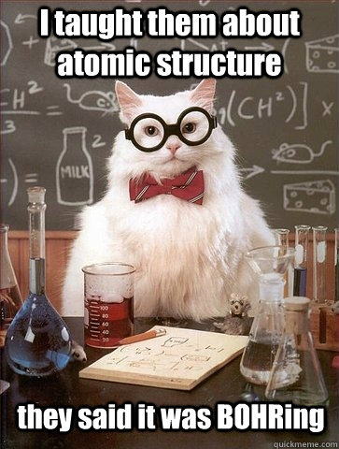
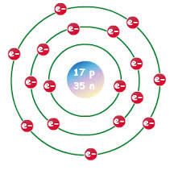
Bohr Model
Bohr Model: Simplified way of drawing an atom and its parts
Bohr Model of Chlorine:
17 protons
17 electrons
35 neutrons

Slide 22
Let’s make a Bohr Model for Carbon…
Get out your periodic tables!!!!!
Find Carbon (atomic number 6)
Be ready to answer questions…

